Slide 1
AS-NEEDED CONSULTANT MEETING
JULY 14, 2016

Slide 2
Agenda
INTRODUCTION:
Contracts Division
Planning and Development
Organizational chart (Planning and Development)
Section’s slides
PLANNING DIVISION
Planning & CEQA
Land Management & Compliance
Trails Planning
DEVELOPMENT DIVISION
Landscape Architecture & Design
Water & Conservation Planning
Facility Planning
SUMMARIZE CONSULTANT PROCESS
QUESTIONS

Slide 3
Planning and Development Agency
Norma E. Garcia - Deputy Director
Norma E. Rivera - Management Sec. III
Planning Division
Kathline J. King - Chief of Planning, Regional Opr. Mgr.
Planning & CEQA
Clement Lau
Section Head, DFP II
Loretta Quach
Dept. Facilities
Planner I
Sheela Kleinknecht
Park Planner
Jui Ing Chien
Park Planner
Julie J. Yom
Park Planner
Justine Murillo
Student Worker
Land Management & Compliance
Michelle O’Connor
Section Head, DFP II
Bryan Moscardini
Dept. Facilities Planner I
John Diaz
GIS Analyst
Ansley B. Davies
Associate Curator
Narine Hakobyan
Real Property Agent I
Diane Thorne
Admin Assistant III
Development Division
James Smith - Chief of Development, Regional Opr. Mgr.
Norma Morseburg - Sr. Sec. III
Facility Planning
James Barber
Section Head, DFP II
Christopher J. Spisak
Architect
Andrew M. Lopez
Dept. Facilities Planner I
Lee A. Barocas
Dept. Facilities Planner I
Mozaffar M. Bahrami
Dept. Facilities Planner I
Trails Planning
Frank A. Moreno
Section Head, DFP II
Robert L. Ettleman
Park Planner
Olga A. Ruano
Park Planning Assistant
Sarah Perez
Park Planning Assistant
Zachary T. Likins
Park Planning Assistant
Water & Conservation Planning
Bertha Ruiz-Hoffmann
Section Head, DFP II
Natalie Glover
Dept. Facilities Planner I
Changmii Bae
Park Planner
Vacant *
Landscape Architectural Assoc.
Landscape Architecture & Design
Vacant
Section Head, SLA I
Perla Arquieta
Landscape Architect
Catherine Ricci
Landscape Architectural Associate
Nam Hoang
Architect Associate
Jeremy Bok
Landscape Architectural Assoc.

Slide 4
Planning Division
Planning & CEQA
Land Management & Compliance
Trails Planning

Slide 5
Planning & CEQA
Advanced Park Planning
Developer Park Obligations
Quimby Code Administration/Implementation
Quimby Funding Agreements
Park Development Agreements
CEQA Support to PND
CEQA Initial Studies
CEQA Environmental Review/Clearance Language
CEQA Review
e-Consultations
MND/ND/EIR Review
Parks and Recreation Elements of County General Plan
Park Classifications, Ordinances, Specific Plans

Slide 6
Planning & CEQA

Slide 7
Land Management & Compliance
GIS and Parkland Database
GIS Mapping
Land and Easement Acquisitions/Dispositions
Pre-Acquisitions/Due Diligence Coordination
Historic Facilities and Cultural Resources Monitoring
Joint Use Agreements
License Agreements
Right-of-Entry Permits
Notices of Exemption
Park Mitigation Monitoring
Regulatory Compliance
Agency Permitting
Urban Forestry

Slide 8
Land Management & Compliance

Slide 9
Trails Planning
Trails Planning/Master Planning
Off-Highway Vehicle Planning
Trail and OHV Guidelines/Standards
Developer Project Entitlement Review and Trail Obligations
Trail Conditions Monitoring
Trail Inventory and Assessments

Slide 10
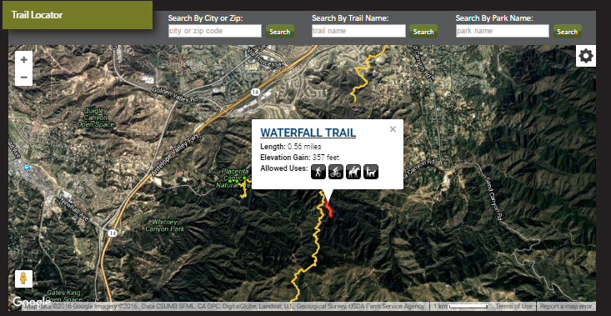
Trails Planning

Slide 11
Development Division
Landscape Architecture & Design
Water & Conservation Planning
Facility Planning

Slide 12
Landscape Architecture & Design
Design Review
Plan Review
Park Design Guidelines and Standards
Park Site Plan Drawing
Design
Conceptual
Schematic
Design Development
Construction Documents
Construction Observation of In House Design Projects

Slide 13
Landscape Architecture & Design

Slide 14
Water & Conservation Planning
Smart Controller Implementation
Recycled Water Implementation
Water Monitoring Program
Education Water Conservation flyers
Solar Energy Project Implementation
Alternative Energy Research
Solar
Wind
Geothermal
Educational Signage
Stormwater Management Implementation
Research
Lake Conditions - coordination with field agencies
Lead of the Water and Energy taskforce meetings
Coordination with field agencies, Department of Public Works, Chief Executive Office
Coordinate review of TMDLS
Coordinate testing with USEPA
Trash TMDL Monitoring - Legg Lake
Legg Lake Educational Outreach Program

Slide 15
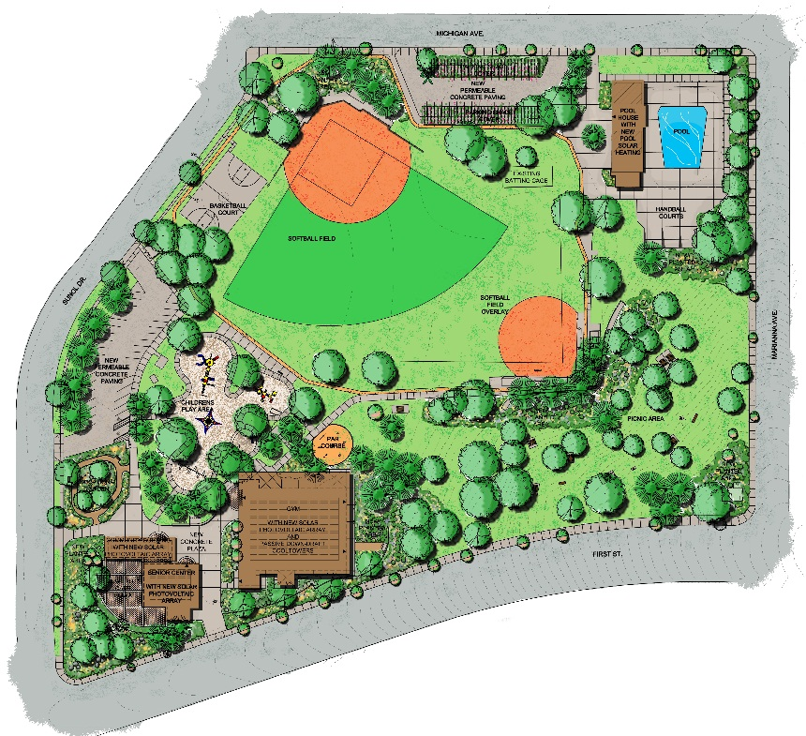
Water & Conservation Planning
Obregon Park Moving Toward Sustainable Efficiency
The First Solar Powered Community Park in LA County
Smart Controller installed in 2012
Efficient Pool Pump (VFD) in 2013

Slide 16
Facility Planning
Defines and Develops Scopes of Work for Capital Improvement Projects
Prepares Facility Programs – Outline Scope of Work Elements Including Environmental, Land Ownership, and Trail Related Issues
Initiate Requests For Consultant Design Proposal Services
Administrate Consultant Services Assignment
Ensure The Consultant’s Compliance With The Project Milestones And Deliverables

Slide 17
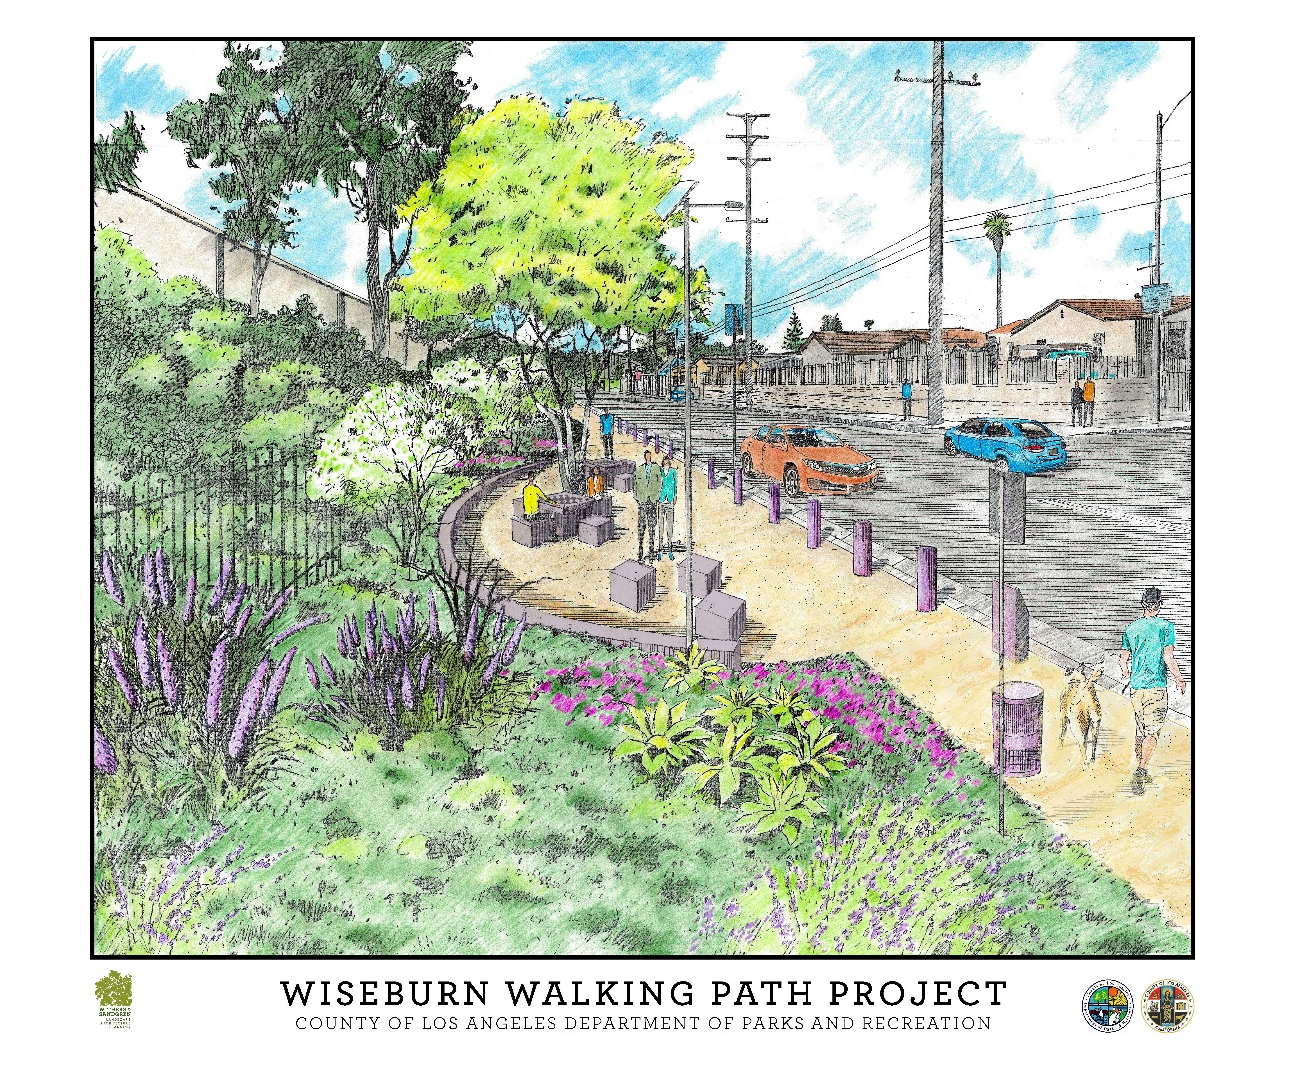
Facility Planning

Slide 18
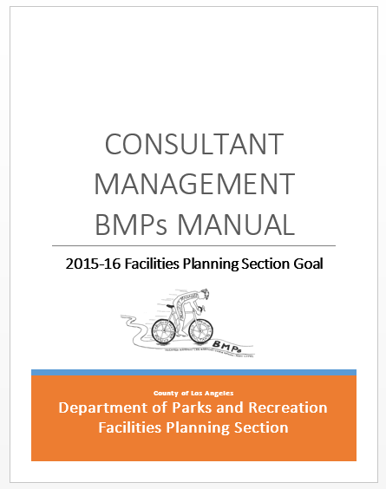
Summarize Consultant Process
Consultant Forms
PIF-1 Project Initiation Form
PMIF-2 Project Management Initiation Form
PAF-3 Project Amendment Form
RFP-4 Request for Proposal
CFP-5pe Consultant Fee Proposal-Planning/Environmental
CFP-5ae Consultant Fee Proposal-Architectural/Engineering
CSFV-6 Consultant Services Funding Verification
NTP-7 Notice to Proceed

Slide 19
Summarize Consultant Process
Mini Solicitation
P.I.F.
ASSIGN PM
Facility Program
Consultant services
P.I.F.-1
Scope
R.F.P.-4
P.M.I.F.-2
R.F.P.-5 PE 5 AE
P.I.F. Amend
C.S.V.-6
P.A.F.-3
N.T.P.-7

Slide 20
Questions?
?

